Slide 1

FIFA WORLD CUP SUCCESS VS WEATHER EFFECT
Baris Yalcin,
Gregory O’Brien,
Henry Greyner,
Mike Sammis,
Volkan Kaya

Slide 2
Introduction;
WHY we chose the subject? 2 reasons;
1st, in futbol there is an old saying; ‘world cup does not go too far from home! We wanted test if this saying is true!
Notes:
Clearly explain what is this project about. Use common, basic words to present it to all knowledge levels.

Slide 3
2nd, world cup is most watched and attracted event in the world , numbers;
Attracted average of 3.2B people in 2010 & 2014,
MOST WATCHED LIVE events in 21st century
Total impact on host country is ~$30B in 2018
Total tournament cost to FIFA org is ~$14B in 2018
Total prize given in $600M in 2018
Other than ‘quality players, big # supporters, good tactics’, We thought about TEMPERATURE. Which is why we came up with the following hypothesis;

Slide 4

H: There is a better chance to be successful if a world cup team comes from a similar climate as the host country.

Slide 5

NH; There is no correlation between the weather and team success.
They just need to play hard ;)

Slide 6
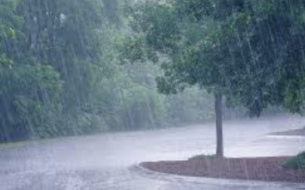

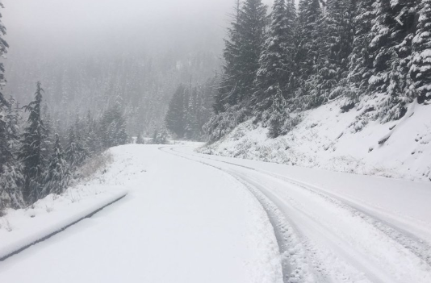

# Weather Data study

Slide 7
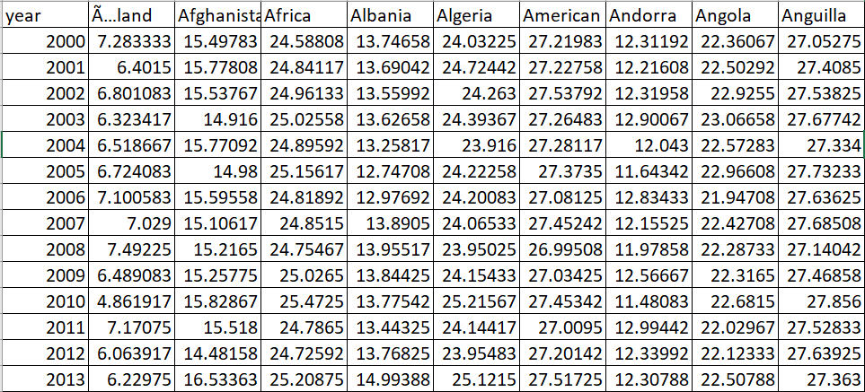

A) Weather API website and data
https://openweathermap.org/api
We used 4 different climates, cold, mild, warm, and hot.
COLD: Equal or below 8 C
MILD: between 9 C and 15 C
WARM: between 16 C and 25 C
HOT: equal or above 25 C

Slide 8
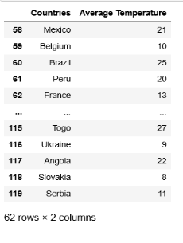
B) Average temperature of incoming teams, graph

Slide 9
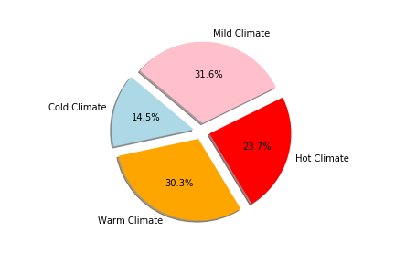
C) Percentage of “Cold/ Mild/ Warm/ Hot” countries in tournament, pie chart

Slide 10
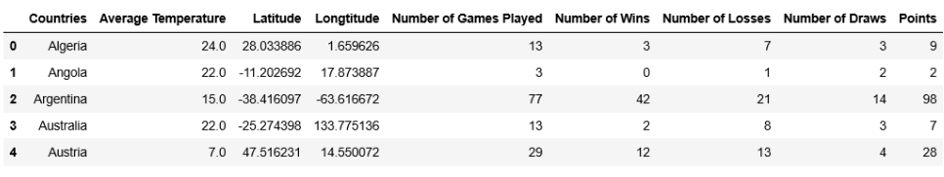
D) Average temperature of “Cold/ Mild/ Warm/ Hot” countries VS their total points, table

Slide 11
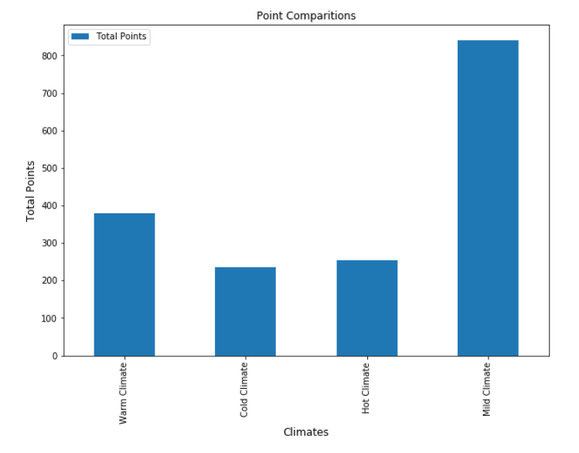
E) Total points of “Cold/ Mild/ Warm/ Hot” countries in tournament, graph chart

Slide 12
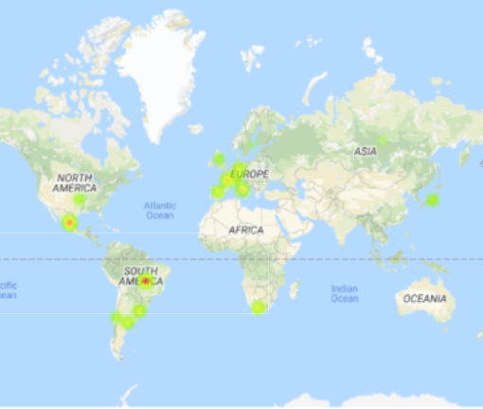
F) Finding average temperature of host cities-HEAT MAP

Slide 13
Merging Weather data with World Cup Matches
Scraping a table from Wikipedia using bs4 to compare with our point system
Getting historical weather data from summer of 2019
Merging national temperature averages and city temperature with our main dataframe

Slide 14
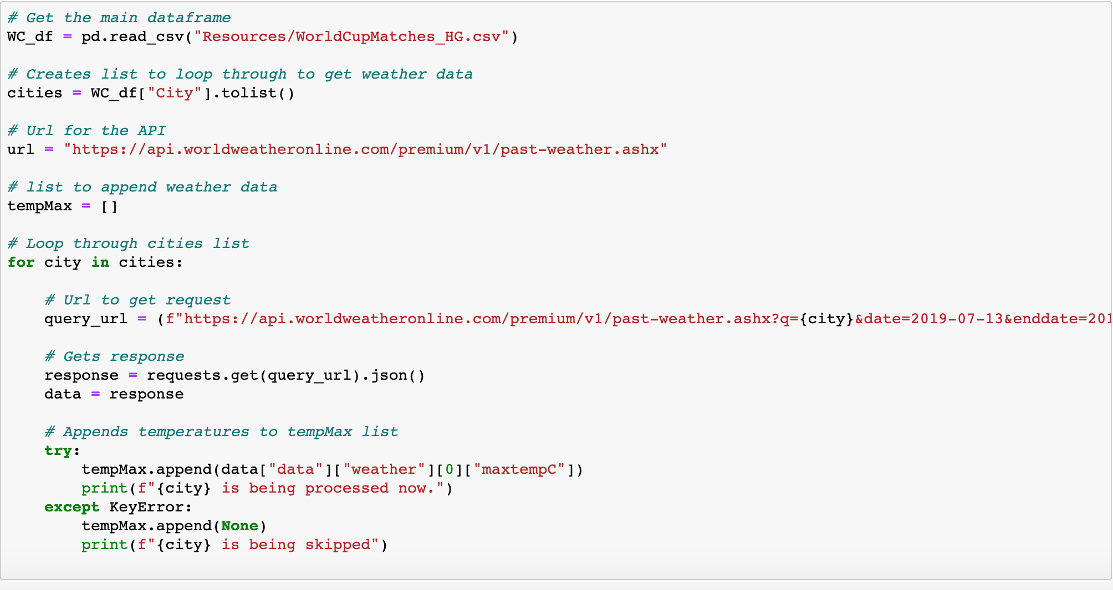

Slide 15
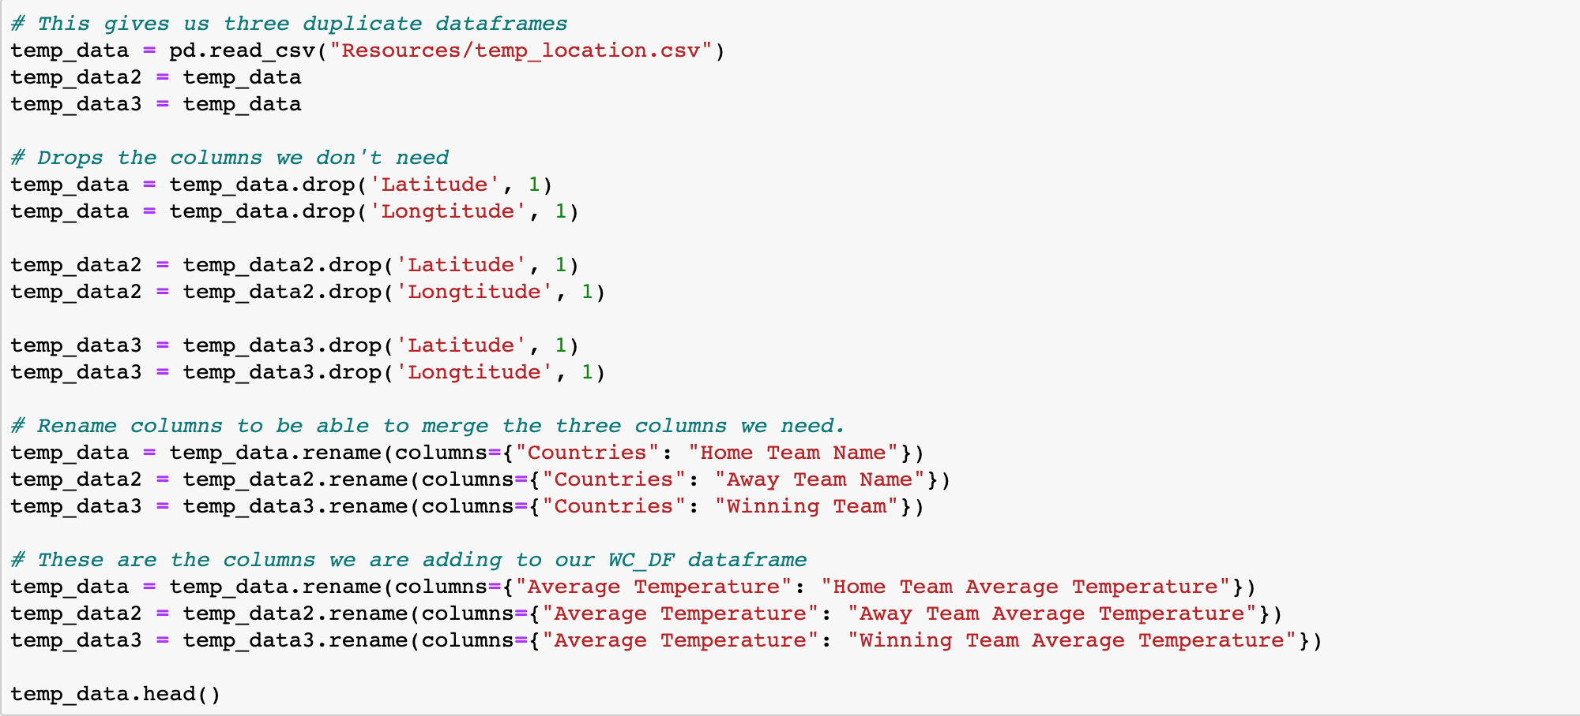
Merging weather data

Slide 16
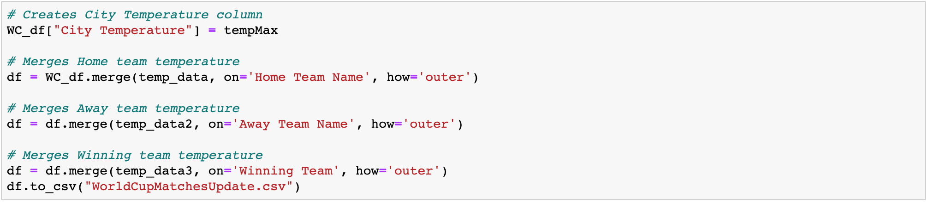
Merging weather data

Slide 17
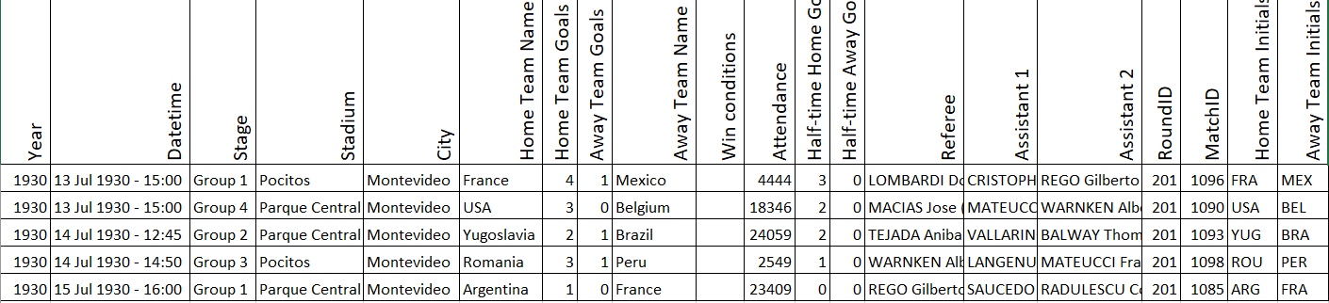
G) Football world cup website and CSV data
https://www.kaggle.com/abecklas/fifa-world-cup

Slide 18
H) What makes a soccer team “successful” for us; Authentic Point System (APS)!
We came up with our authentic point system to order teams from most successful to the least. For a team to earn points, we use 2 points for a win; and 1 points for a tie. It shows very similar results between the countries who won the most cups and the countries who gets the most of points. Which makes our points system unbiased.

Slide 19

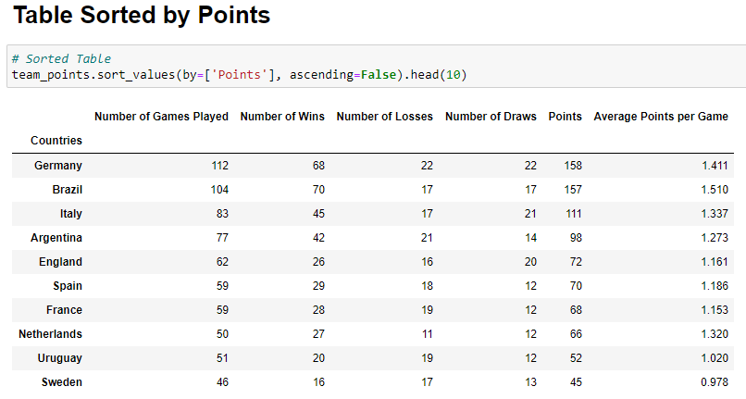
I) Comparison of team’ points
Brazil
Germany
Italy
Argentina
France
Uruguay
England
Spain

Slide 20
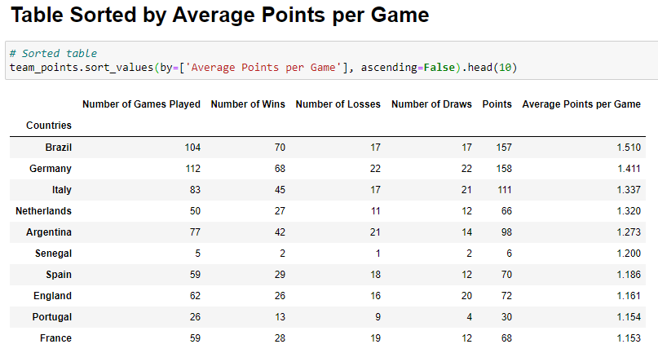
I) Comparison of team’ Avg Points per Game
Brazil
Germany
Italy
Argentina
France
Uruguay
England
Spain

Slide 21
How does temperature figures in all this?
What are the “deltas”?

Slide 22




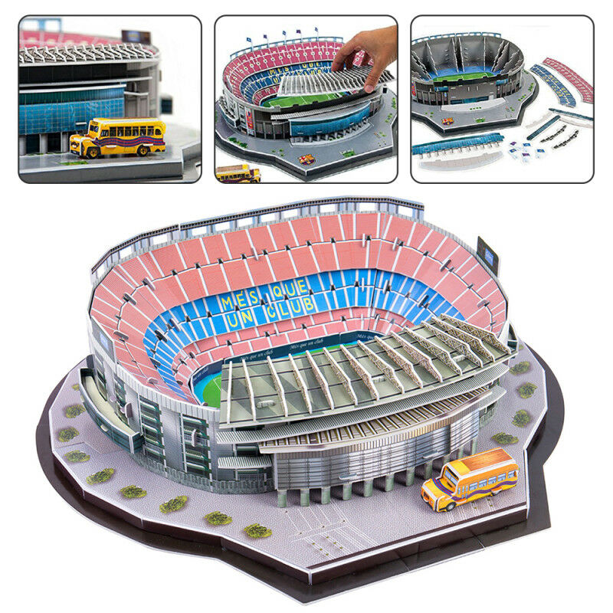
Team A
Team B
VS
Do the results of the game depend on temperature?

Slide 23

# Combining football and weather data

Slide 24
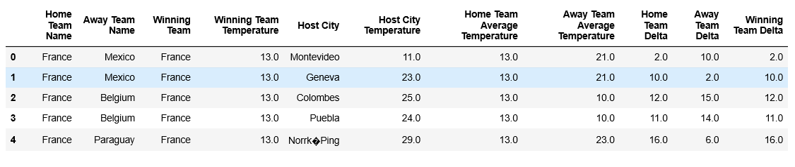
J) Table showing Temperature Deltas calculations

Slide 25
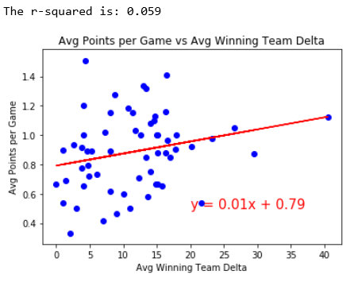
K) Average points vs winning team delta, scatter Plot

Slide 26
CONCLUSION:
Our argument was, there is a better chance to be successful in the world cup if a team comes from a similar climate as the host country.
We tested our HYPOTHESIS, we could not accept nor reject. We could not find significant correlation between temperature and success in the futbol tournament.

Slide 27
CONCLUSION #2:
We could not either accept or reject the hypothesis because we plotted the mean delta temperature a against success based on our point system. After doing a linear regression, R-squared value was 0.059 and the slope was 0.01, indicating that there is no correlation between success with our point scale versus temperature data. We do not have enough evidence to reject the null hypothesis.

Slide 28
CONCLUSION #3:
Challenges we faced!;
-Data cleaning; We found data with faults, duplicates, format errors
-Finding a large data to test the hypothesis
-Assumptions for Country Avg Weather

Slide 29
Thanks!

Slide 30
Q&A

